Slide 1
Machine Learning discovers p53 cancer rescue regions
Sam Danziger,
Roberta Baronio, Linda V. Hall, Lydia Ho, Kirsty A. Salmon, G. Wesley Hatfield, Peter Kaiser
and Richard H. Lathrop
11/17/08

Slide 2
Outline
Introduction
p53 Cancer Rescue Mutants.
Computer Guided Mutant Discovery.
Active Learning.
  Most Informative (MI).
  Most Informative Positive (MIP).
Calculate Cancer Rescue Regions.
Results and Conclusions.

Slide 3
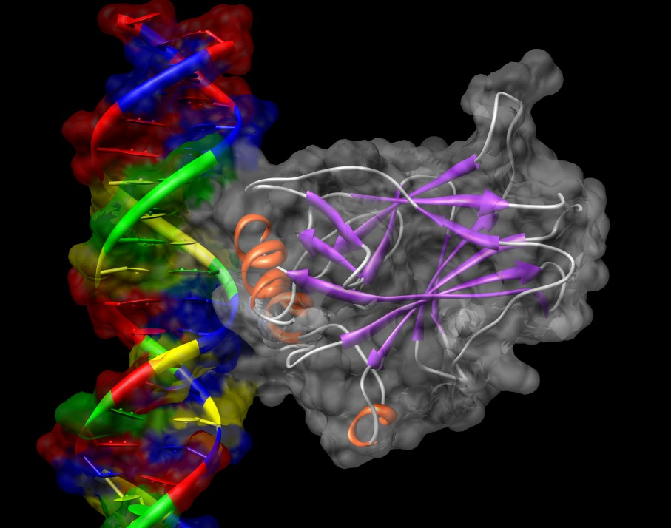
The Problem: p53 and Cancer
1 in 3 people will get cancer
p53 Tumor Suppressor Protein.
p53 mutations occur in ~50% of human cancers.
Fixing p53 has shrunk tumors in animal models.
p53 core domain bound to DNA
Image Generated with UCSF Chimera
Cho, Y. et al. Science (1994)
Notes:
Spend some time on “Tumor Supressor Protein”. It’s a chain consisting of the 20 amino acids folded up into a glob.
Norman E. Sharpless - Nature (2007)

Slide 4
Ultimate Goal
Rescue Cancer Causing p53
Cancer
Wild Type
Active p53
1 Mutation
Inactive p53
2+ Mutations
Active p53
Cancer
+
=
Anti-Cancer Drug
Inactive p53
Active p53

Slide 5
Computers Help Solve Hard Biological Research
Biology
p53 Research
Computer Models
Machine Learning
Notes:
We use a computer to build a model p53. The computer will then tell us which ways that p53 can break would be interesting for us to make it in the lab.

Slide 6
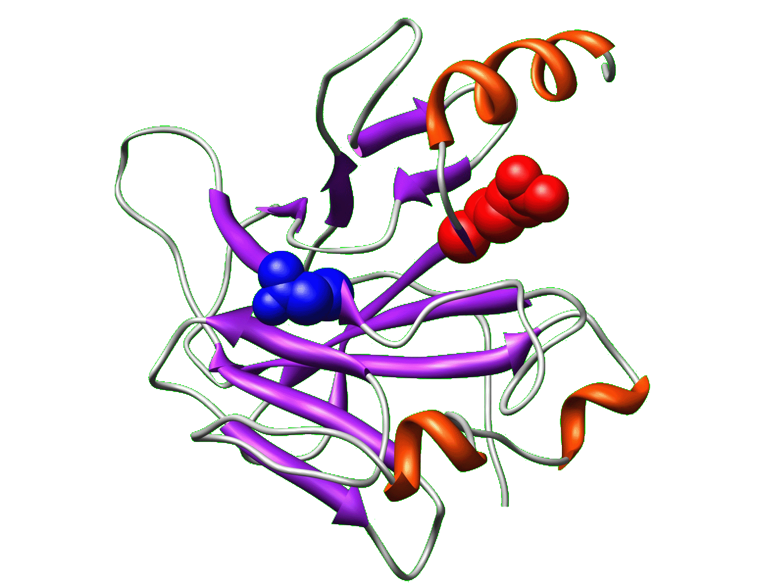
Computer Guided Discovery
Use Active Learning to select the mutants that will be the most informative.
Test the predictions in-vitro.
Build classifier based on mutants with a known function.
Find all useful mutant proteins
Knowledge
Model
Experiment

Slide 7
Outline
Introduction
p53 Cancer Rescue Mutants.
Computer Guided Mutant Discovery.
Active Learning.
  Most Informative (MI).
  Most Informative Positive (MIP).
Calculate Cancer Rescue Regions.
Results and Conclusions.

Slide 8
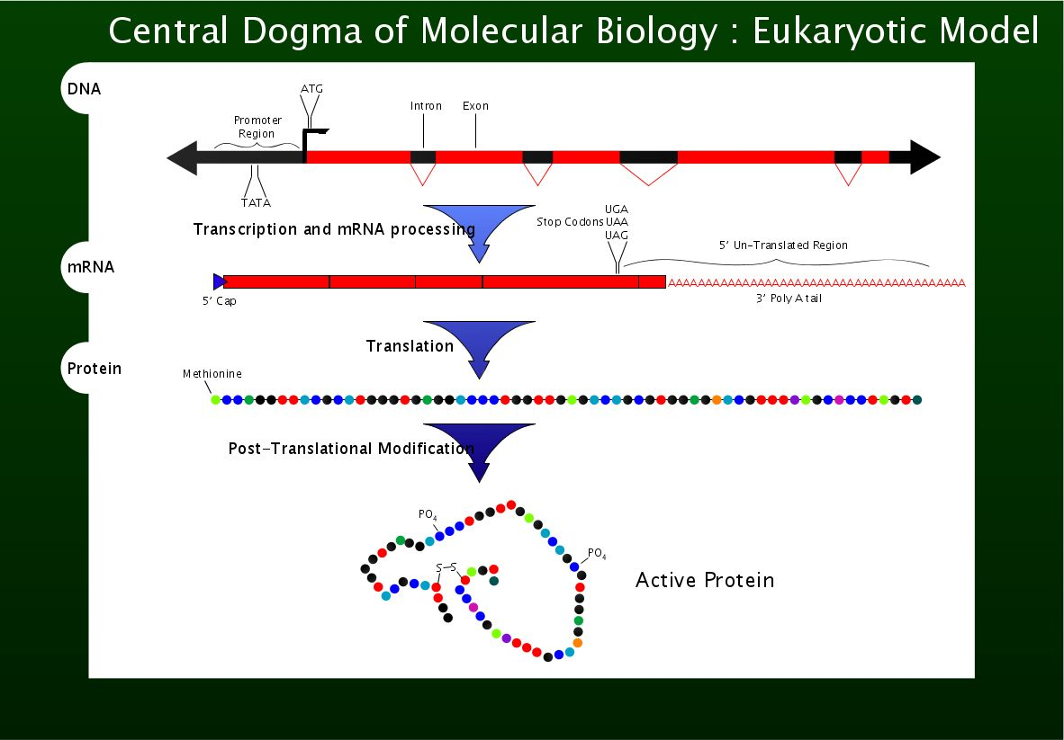
4 Letters: Deoxyribonucleic Acids
4 Letters: Ribonucleic Acids
20 Letters: Amino Acids
Folded
http://en.wikipedia.org/wiki/Image:Cdmb.svg

Slide 9
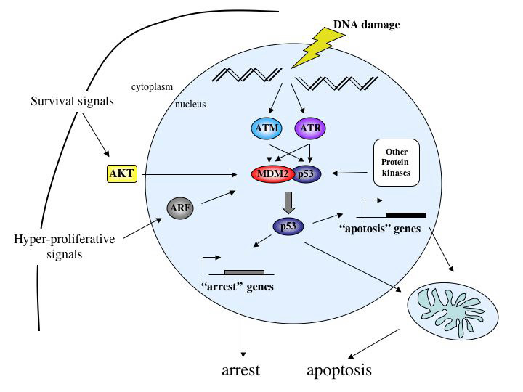
The p53 Cancer Prevention Pathway
David W. Meek: http://www.dundee.ac.uk/biomedres/meek.htm
Notes:
The p53 is the master regulator? Of the genome. Look for quote in the paper.

Slide 10
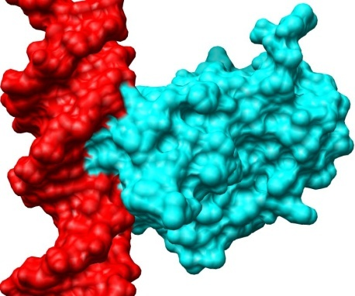
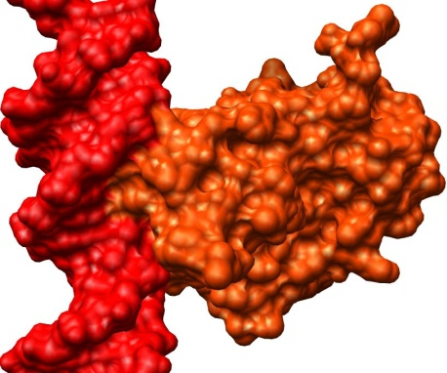
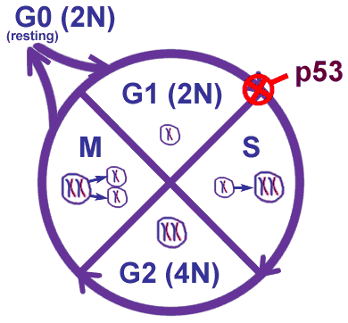
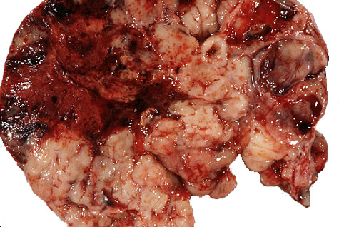
p53 & Cancer Prevention
Healthy Cell
Cancer
1a) Damaged DNA |
Active P53
2a) Damaged DNA |
Inactive P53
If p53 Breaks..
http://www.barrettsinfo.com/figures/cycle-p53.gif
1b) DNA Repair or Apoptosis
www.vh.org/adult/provider/pathology/OBGYNOncology/Images/Endo1.jpg
2b) Cancer
Notes:
We want to know everything that we can about p53!!!!

Slide 11
Cancer Rescue Mutations
R249S
273
248
175
N235K
245
282
N
C
1-42
102-292
324-355
Transactivation
Core domain for DNA binding
Tetramerization
Cancer mutation prevalence data from the IARC p53 database: http://www-p53.iarc.fr/
Notes:
Explain R @ 249 -> S
Add appearing boxes that say “Cancer -> Inactive” “Cancer+Rescue -> Active”

Slide 12
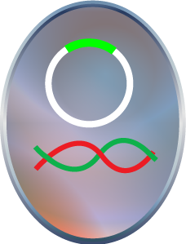
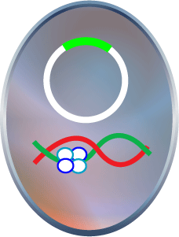
Evaluating Cancer Rescue Mutants in the Wet Lab
INACTIVE
ACTIVE
A Yeast containing an inactive p53 cancer mutant
will not grow.
A Yeast containing an active p53 cancer rescue mutant
will grow.
Baroni, T.E., et al. Proc Natl Acad Sci U S A, 101, 4930-5.
Notes:
Fix the second picture. The tetramer binds to the p53 DNA

Slide 13
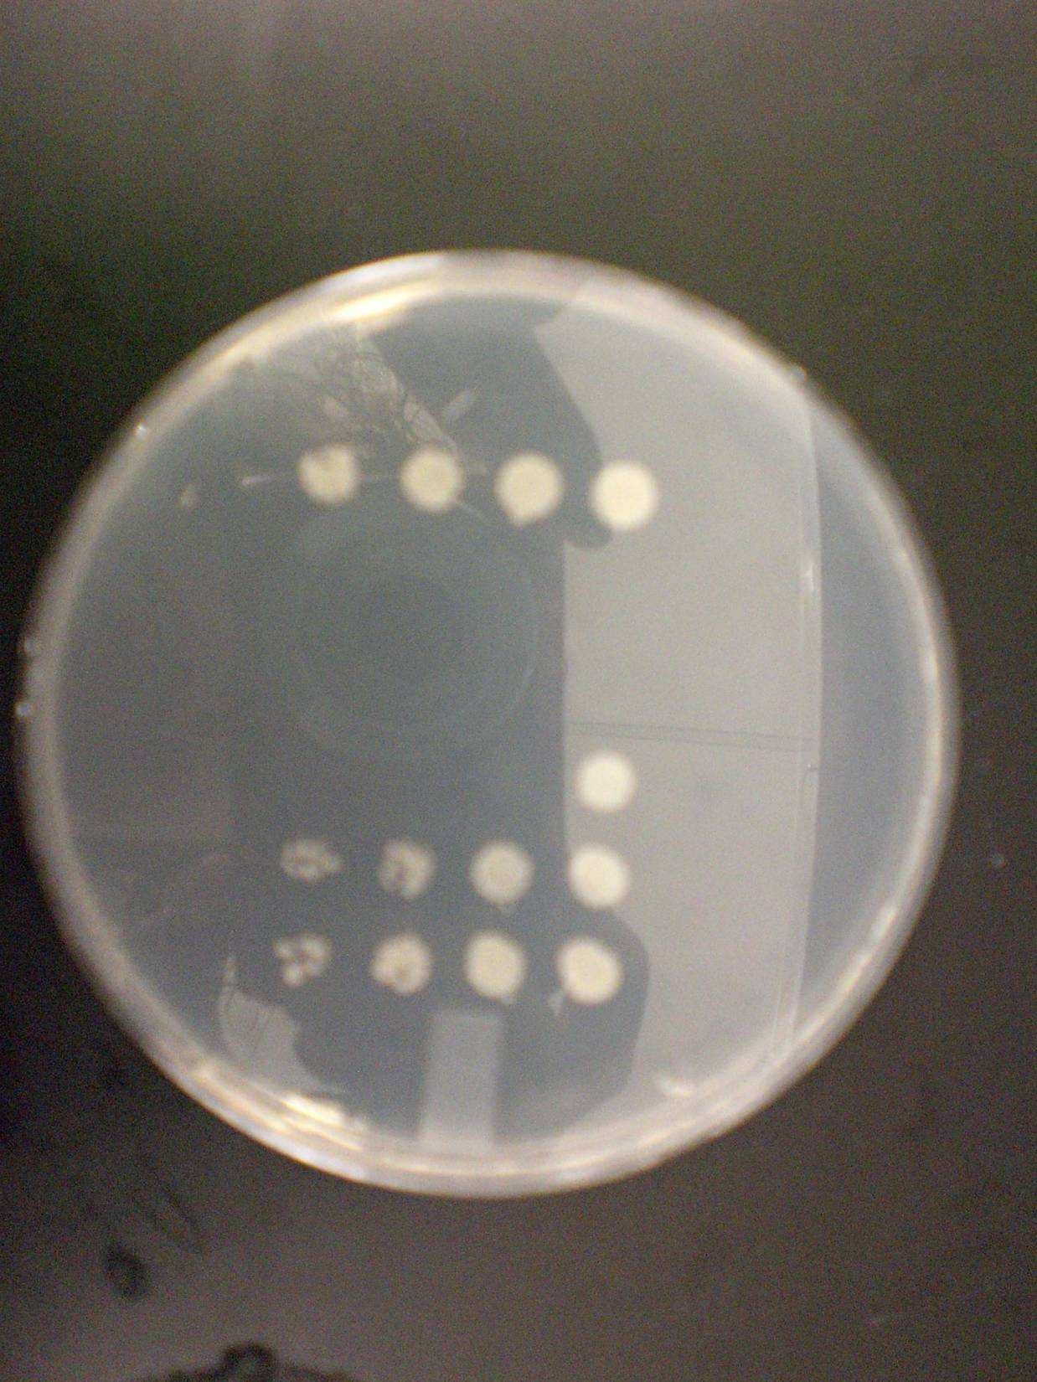
p53 Rescue Assay
Human p53 may be expressed in yeast assay.
463 different p53 mutants have already been assayed.
Strong mutants grown nearly as well as Wild-type.
Weak mutants grow, but not well.
Concentration
wt
r158l
r158l_y234v
r158l_y234l
r158l_n235k
r158l_l201p

Slide 14
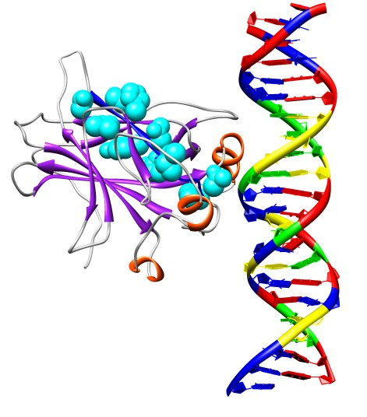
Cancer Rescue Hot Spots
86.7% (72/83) Cancer Rescue Mutants occur in the 230-240 region.
Some cancer mutants are currently unrescuable.
Can we find more rescue mutant “Hot Spots” ?

Slide 15
Discovery Of Active Mutant Proteins
Starting Point: p53 - A biomedically important protein with some known mutants.
Problem: Find novel mutant proteins with an Active phenotype.
Naive Solution: Make and test all other possible mutants in the wet lab.
Known
Mutants
Other Possible Mutants
Notes:
For example, Flu, TB, HIV and Cancer – the topic of this talk.

Slide 16
Outline
Introduction
p53 Cancer Rescue Mutants.
Computer Guided Mutant Discovery.
Active Learning.
  Most Informative (MI).
  Most Informative Positive (MIP).
Calculate Cancer Rescue Regions.
Results and Conclusions.

Slide 17
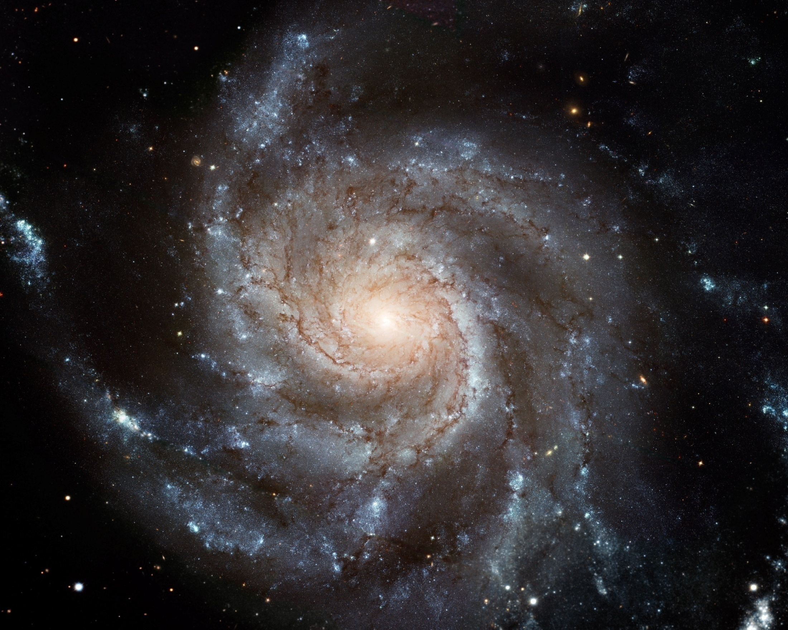
Why Use Computers?
Assuming up to 5 mutations in 200 residues
How Many Mutants are There?: ~10^11
Known Mutants: ~10^2
Known Mutants
Spiral Galaxy M101
http://hubblesite.org/
~10^9 stars.

Slide 18
How Can Computers Help?
 | Computer | Wetlab
# Mutants | 106816 | ~5700 (Saturation Mutagenesis)
Time | ~2 weeks computer time. ~4 weeks actual time. | ~7 weeks preliminary. ~7+ months for final results.

Slide 19
Overview:
Representing p53 in silico
2D Features
p53
Wild type
Crystal
p53
Mutant
Crystal
Amber™ Homology Modeler
5834
Attributes
550
Attributes
3D Features
Attribute Selection
1D Features
Amino Acid Changes
4D Features

Slide 20
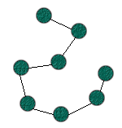
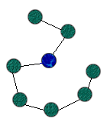
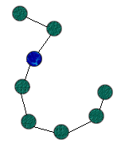
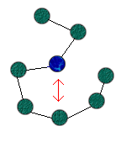
Simulating Mutant Proteins: Homology Modeling
2. Substitute one or more amino acids to mutate the protein.
1. Take a wild type crystal structure of the protein in question.
4. Minimize the energy of the new mutant protein.
3. Apply simulated physical laws to determine an energy function.

Slide 21
Attribute Extraction
Simulated Structure -> String of Numbers
1D: Sequence Mutation – 446
2D: Surface Map – 4826
3D: Atomic Position – 560
4D: “Time Dependant” Stability – 2
Total: 5834 Attributes / mutant
Notes:
Replace this with a picture showing a homology model being turned into a string of numbers.

Slide 22
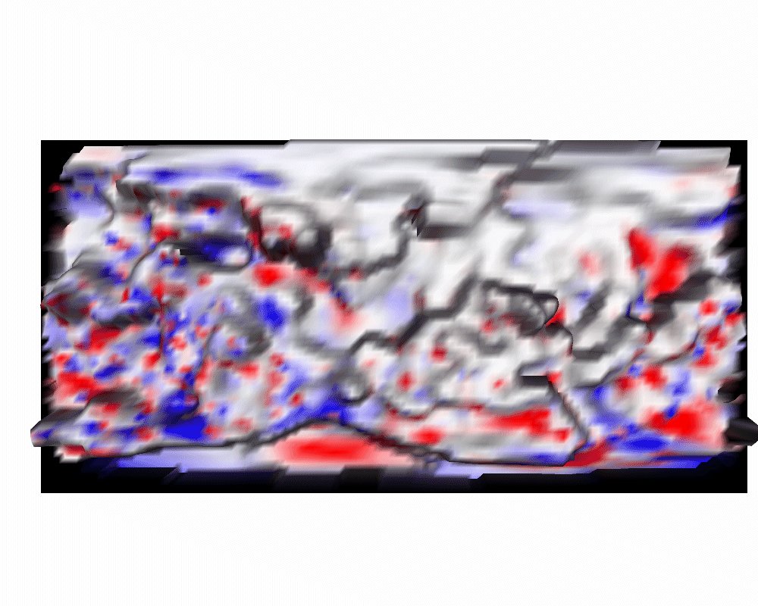
2D: Surface Map*
Created a surface map using well known cartographic techniques
4889 Positional attributes
4889 Electrostatic attributes
9778 total attributes / mutant
*Thanks to Jonathan Chen and Ray Luo
9778 Attributes / mutant
Notes:
For example, here’s one set of features to give you some idea of how attribute extraction works.

Slide 23
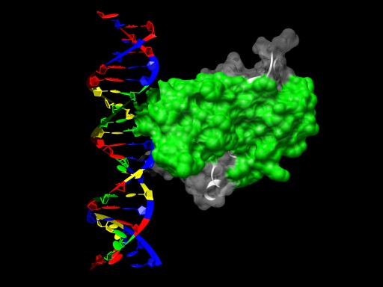
Biology: Promiscuous Binding Region
5
3
5
3
5
3
3
3
5
5
3
3
5
3
3
5
5
5
3
3
3
5
3
5
3
5
3
5
3
5
5
5
1
1
5
5
3
7
7
7
5
5
1
5
3
3
7
7
1
1
1
1
3
3
3
7
1
5
5
5
7
7
3
3
4
5
3
3
3
5
3
3
5
3
5
3
5
3
5
5
5
A. Friedler et al. The Journal of Biological Chemistry (2005)
3
5
4826 Attributes / mutant
Notes:
In the above protein, there is a biologically active region that’s known to interact with many other molecules

Slide 24
What is Machine Learning? m Example, n Attributes
Example 1
Example 2
…
Example m
A₁₁ | A₁₂ | … | A_{1n}
A₂₁ | … | … | …
… | … | … | …
A_{m1} | … | … | A_{mn}
W₁
W₂
…
W_{n}
Class 1
Class 2
…
Class m
Training: Set the parameters with n features.
Testing: Use the parameters to predict unknown classes
W₁
W₂
…
W_{n}
Unknown
A₁₁ | A₁₂ | … | A_{1n}
Prediction
Notes:
How much time is saved? Computer:

Slide 25
Outline
Introduction
p53 Cancer Rescue Mutants.
Computer Guided Mutant Discovery.
Active Learning.
  Most Informative (MI).
  Most Informative Positive (MIP).
Calculate Cancer Rescue Regions.
Results and Conclusions.

Slide 26
Active Learning Overview
Find Cancer Rescue Mutants
Knowledge
Theory
Experiment
Notes:
Replace the book with a chimera picture of p53 in this diagram.
Replace the experimenter with another computer picture

Slide 27
A Better Solution: Active Learning
Pick the best unknown mutants to know
Known
Unknown
Example 1
Example N+1
Train the Classifier
Example 2
Classifier
Example N+2
Example 3
Example N+3
…
Choose Example (s) to Label
Example N+4
Example N
…
Example M
Training Set
Add New Example
To Training Set

Slide 28
Outline
Introduction
p53 Cancer Rescue Mutants.
Computer Guided Mutant Discovery.
Active Learning.
  Most Informative (MI).
  Most Informative Positive (MIP).
Calculate Cancer Rescue Regions.
Results and Conclusions.

Slide 29
An Example of Active Learning:
Minimum Marginal Hyperplane
Should unknown Mutant 1 or Mutant 2 be added to the training set?
INACTIVE
Known
Inactive
Known
Active
1
1
Unknown
Mutant 1
2
2
Unknown
Mutant 2
ACTIVE
Select Mutant 2

Slide 30
Another Example:
Maximum Curiosity
Should Mutant 1 or Mutant 2 be added to the training set?
Change in correlation coefficient
Training Set
Training Set +
Mutant 1 (Active)
Cross-validator
.0411
Training Set +
Mutant 1 (Inactive)
Cross-validator
-.6014
Training Set +
Mutant 2 (Active)
Cross-validator
.0309
Training Set +
Mutant 2 (Inactive)
Cross-validator
.0276
Select Mutant 1

Slide 31
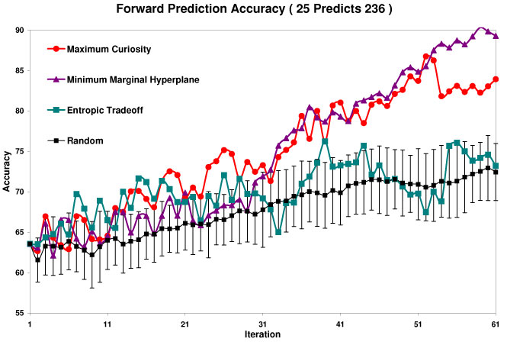
How Fast Does It Learn?
The Three Previous Examples
Notes:
Preserve the colors from the previous slide. CHANGE THE TITLE?

Slide 32
How Accurate On The Chosen?
The Previous Examples
 |  | 204 Predicts 57
Type | Method | Accuracy | Correlation Coefficient | Student-T
I | Maximum Curiosity | 77.19% +/- 5.61% | .5255 | 0.00%
III | Minimum Marginal Hyperplane | 64.91% +/- 6.38% | .2845 | 100.0%
IV | Entropic Tradeoff | 80.70 % +/- 5.27% | .4860 | 99.89%
C | Non-iterated Prediction | 56.14% +/- 6.63% | .2530 | 100.0%
C | Predict All Inactive | 80.70% +/- 5.27% | .0000 | 99.89%
C | Random (30 trials) | 74.39% +/- 3.87% | .3550 +/- .0992 | 99.24% +/- 2.89%
Notes:
Types are in the paper. Point out that “C” is a control. CLEAN UP FONT DIFFERENCES

Slide 33
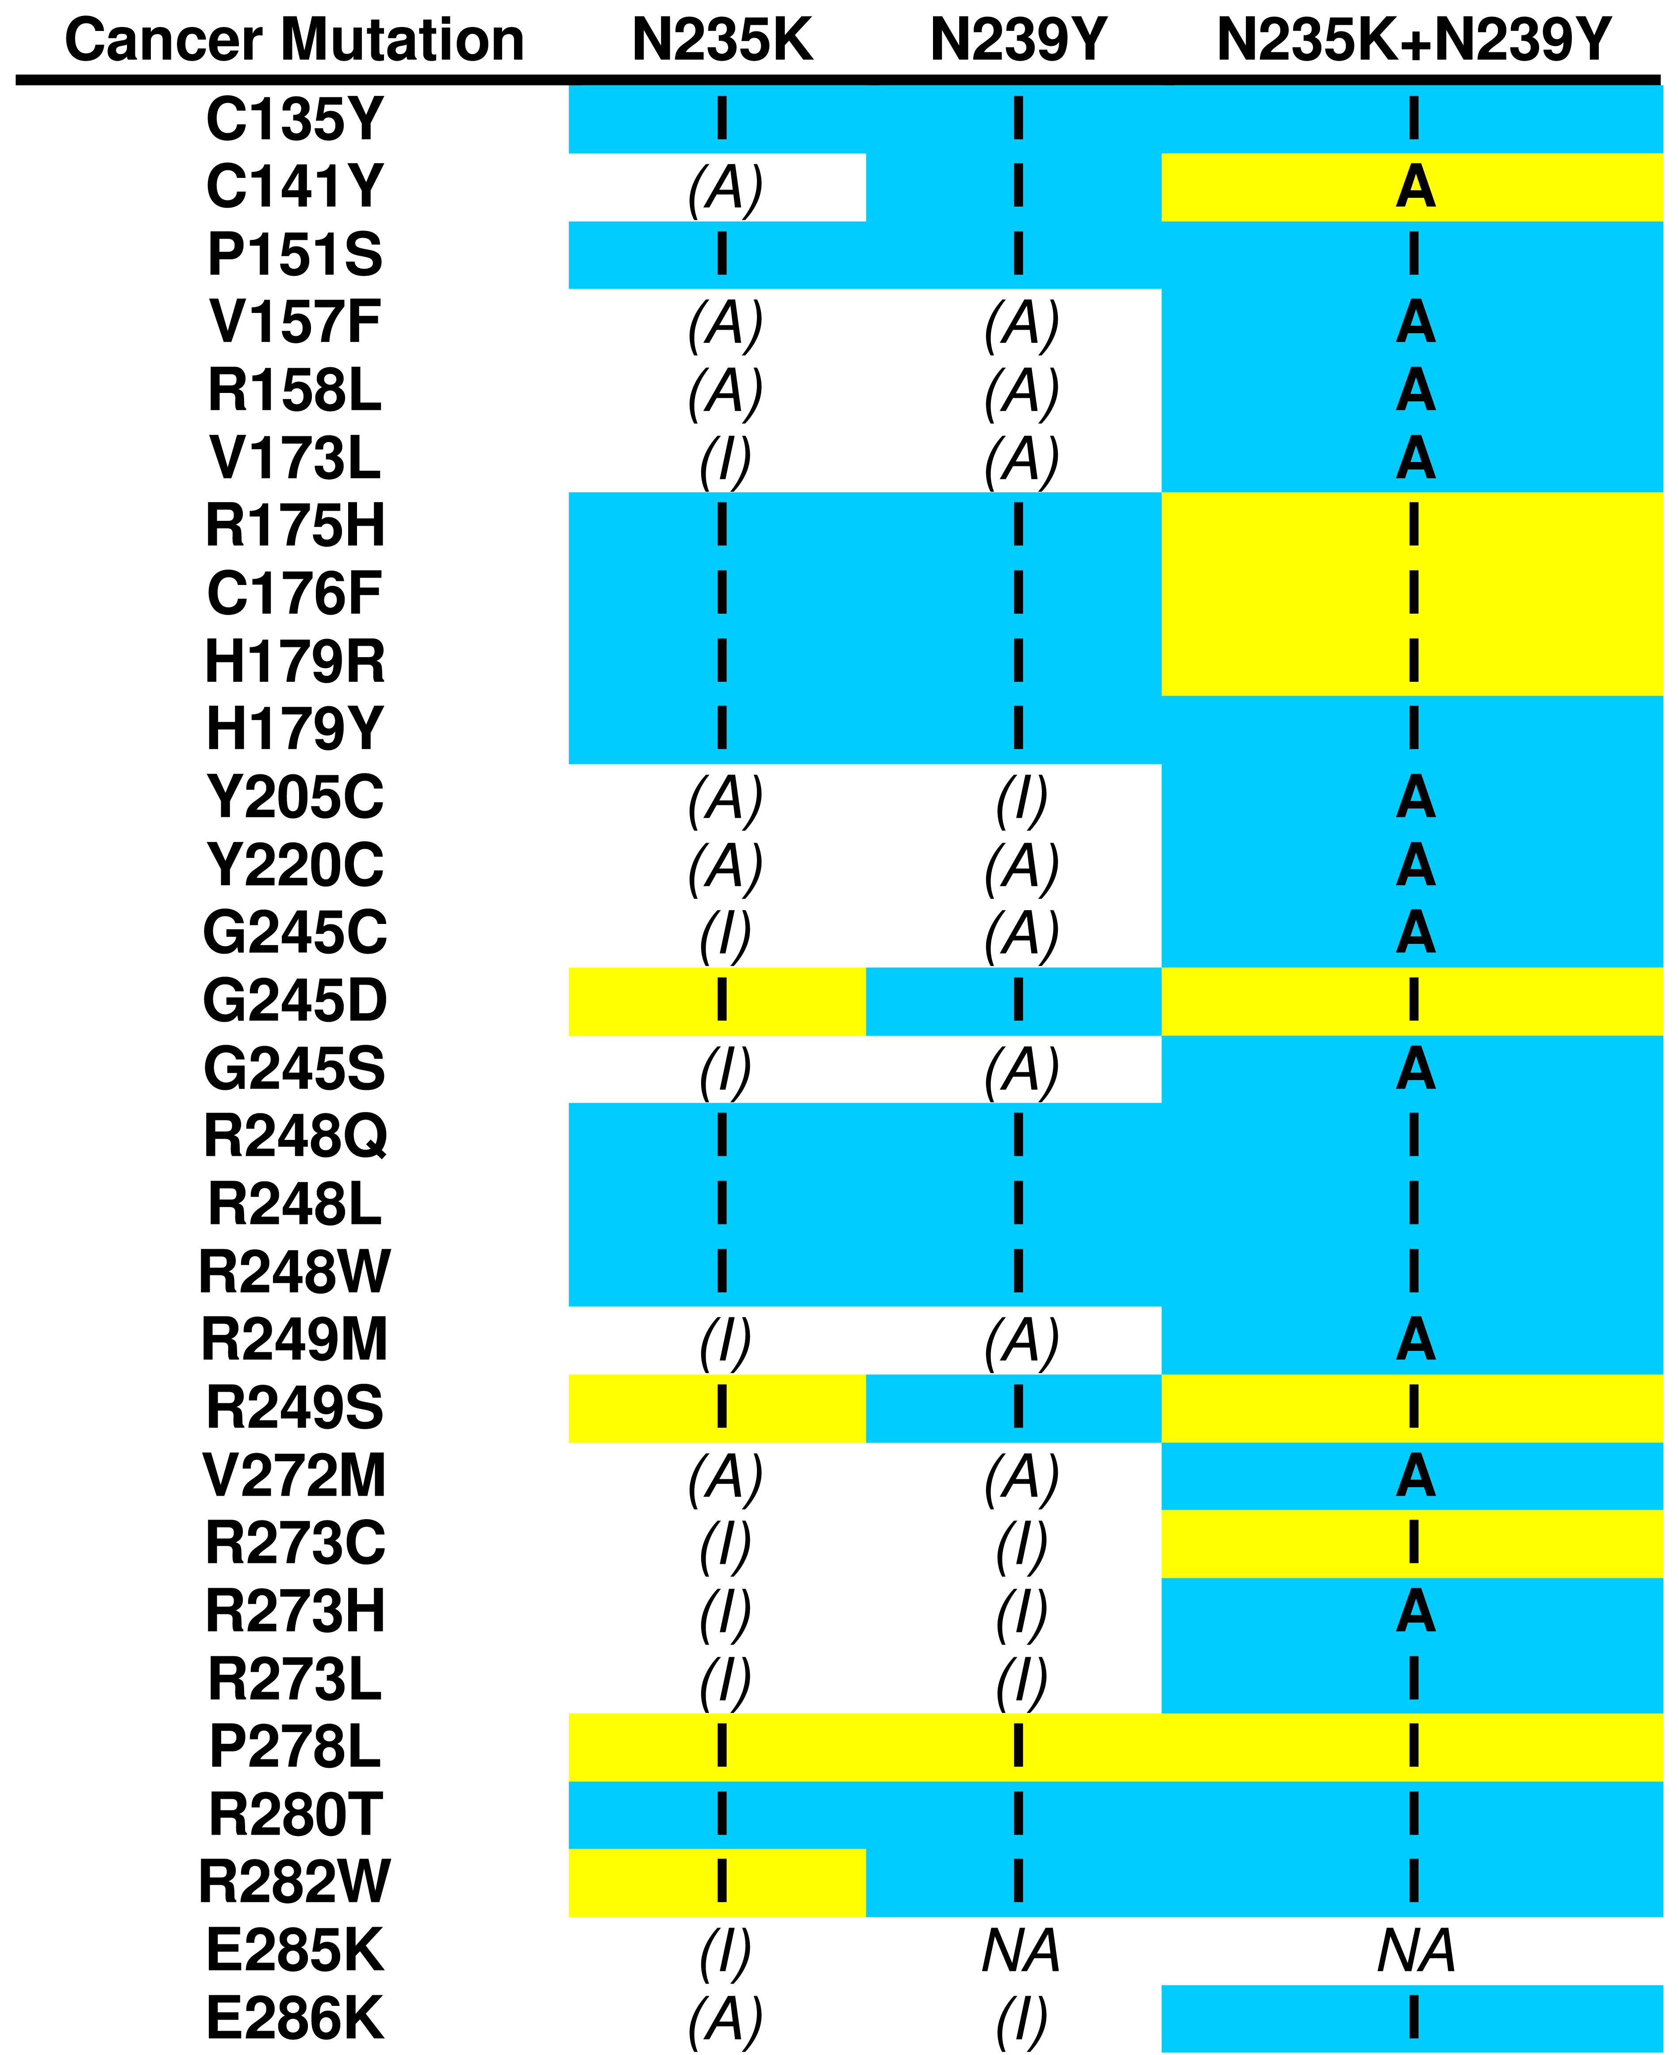
Do These Models Predict Anything?
Blue: Correct
Yellow: Incorrect
White: No Prediction
Accuracy:
77.19%
Correlation Coefficient (r)*:
.5255
*0 is bad, 1 is good, .5 okay
Predicted all inactive: r = 0
Notes:
Correlation Coefficient: 0 is bad, 1 is good, .5

Slide 34
Outline
Introduction
p53 Cancer Rescue Mutants.
Computer Guided Mutant Discovery.
Active Learning.
  Most Informative (MI).
  Most Informative Positive (MIP).
Calculate Cancer Rescue Regions.
Results and Conclusions.

Slide 35
An Example of Active Learning:
Minimum Marginal Hyperplane
Should unknown Mutant 1 or Mutant 2 be added to the training set?
INACTIVE
Known
Inactive
Known
Active
1
Unknown
Mutant 1
1
2
2
Unknown
Mutant 2
ACTIVE
Select Mutant 2

Slide 36
Another Example:
Maximum Curiosity
Should Mutant 1 or Mutant 2 be added to the training set?
Change in correlation coefficient
Training Set
Prediction
Training Set +
Mutant 1 (Active)
Cross-validator
.0411
Inactive
Training Set +
Mutant 1 (Inactive)
Cross-validator
-.6014
Inactive
Training Set +
Mutant 2 (Active)
Cross-validator
.0309
Active
Training Set +
Mutant 2 (Inactive)
Cross-validator
.0276
Active
Select Mutant 2

Slide 37
Another Example:
Additive Curiosity
Should Mutant 1 or Mutant 2 be added to the training set?
Change in correlation coefficient
Training Set
Prediction
Training Set +
Mutant 1 (Active)
Cross-validator
.0411
Active
Training Set +
Mutant 1 (Inactive)
Cross-validator
-.6014
Active
Training Set +
Mutant 2 (Active)
Cross-validator
.0309
Active
Training Set +
Mutant 2 (Inactive)
Cross-validator
.0276
Active
Select Mutant 2

Slide 38


Metric Definitions
Enrichment Factor:
Positive Area:
Halfway Point:
The % of total iterations before ½ of the active mutants are uncovered.

Slide 39
Enrichment Factor

Slide 40
Positive Area

Slide 41
MIP Active Learning Summary
 | Halfway Point |  | Enrichment Ratio |  | Positive Area
 | MI | MIP | MI | MIP | MI | MIP
Additive Curiosity | 0.472 | 0.317 | 1.073 | 1.300 | 0.533 | 0.636
Maximum Curiosity | 0.406 | 0.341 | 1.095 | 1.176 | 0.565 | 0.599
Minimum Marginal Hyperplane | 0.423 | 0.356 | 1.194 | 1.222 | 0.590 | 0.594
Minimum Entropy | 0.666 | 0.381 | 0.667 | 1.161 | 0.384 | 0.579
Random (100 Trials) | 0.5023 +/- 0.0835 |  | 1.0272 +/- 0.3376 |  | 0.5083 +/- 0.054
Notes:
Review What Enrichment Ratio, Halfway Point, and Positive Area are.

Slide 42
MIP: Lost Accuracy?
Accuracy | 204 Predicts 57 |  | 25 Predicts 236
 | MI | MIP | MI | MIP
Maximum Curiosity | 75.24 | 76.80 | 70.52 | 68.43
Additive Curiosity | 70.47 | 74.85 | 67.73 | 69.84
Additive Bayesian Surprise | 71.93 | 78.46 | 67.84 | 68.28
Maximum Entropy | 78.56 | 77.58 | 70.74 | 69.57
Minimum Entropy | 73.68 | 77.58 | 68.41 | 67.70
Minimum Marginal Hyperplane | 76.61 | 76.12 | 69.57 | 69.26
Maximum Marginal Hyperplane | 73.68 | 77.58 | 68.41 | 67.70
Random (32 Trials) | 73.39 | 76.12
sDEV | 1.68 | 1.18
Correlation Coefficient | 204 Predicts 57 |  | 25 Predicts 236
 | MI | MIP | MI | MIP
Maximum Curiosity | 0.42 | 0.39 | 0.34 | 0.26
Additive Curiosity | 0.34 | 0.29 | 0.27 | 0.31
Additive Bayesian Surprise | 0.34 | 0.46 | 0.27 | 0.29
Maximum Entropy | 0.50 | 0.48 | 0.36 | 0.32
Minimum Entropy | 0.31 | 0.35 | 0.30 | 0.30
Minimum Marginal Hyperplane | 0.44 | 0.47 | 0.32 | 0.31
Maximum Marginal Hyperplane | 0.31 | 0.35 | 0.30 | 0.23
Random (32 Trials) | 0.35 | 0.40
sDEV | 0.05 | 0.04

Slide 43
Outline
Introduction
p53 Cancer Rescue Mutants.
Computer Guided Mutant Discovery.
Active Learning.
  Most Informative (MI).
  Most Informative Positive (MIP).
Calculate Cancer Rescue Regions.
Results and Conclusions.

Slide 44
Which Mutants Should We Make?
Training Set: 463 mutants with known activities.
Test Set: 36787 mutants.
  Top 10 cancer mutants that can be created with 2-3 nucleic acid changes.
  All possible single amino acid rescue mutants that are not known (Amino Acids 96-289).
To Make in vitro: 5700 mutants.
  10 Cancer Mutants * 10 Amino Acid Long Regions * 19 Possible Substitutions * 3 Regions

Slide 45
Calculate an Interesting Region
Score each unclassified mutant
  Assume Mutant is Active.
  Add Mutant to the set of known mutants.
  Score Mutant with 10-fold cross validation.
  Repeat 1-3 assuming Inactive.
  Add up the active + inactive scores for each mutant.
Predict the activity for all unclassified mutants.

Slide 46
Rescue Hot Spot

Slide 47
Outline
Introduction
p53 Cancer Rescue Mutants.
Computer Guided Mutant Discovery.
Active Learning.
  Most Informative (MI).
  Most Informative Positive (MIP).
Calculate Cancer Rescue Regions.
Results and Conclusions.

Slide 48
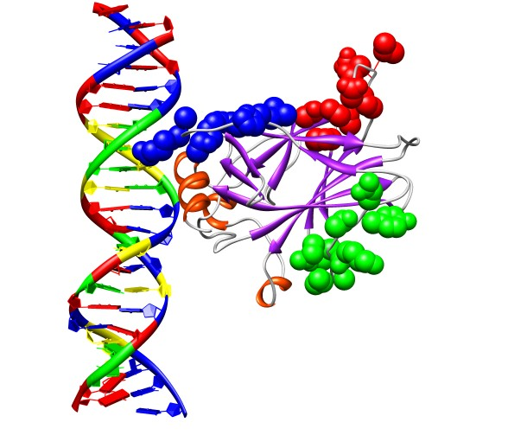
Conclusions: Best Regions to Explore
Predicted Active:
(Green)
Predicted Inactive:
(Red)
Expert predicted Active:
(Blue)

Slide 49
Computation Classifier vs. Expert Biologist
 | Predicted Active | Predicted Inactive | Expert
# Strong Rescue | 8 | 0 | 6
p-Value (1 tail) | - | 0.004 | 0.395
p-Value (2 tail) | - | 0.008 | 0.791
# Weak Rescue | 3 | 2 | 7
p-Value (1 tail) | - | 0.500 | 0.172
p-Value (2 tail) | - | 1.000 | 0.344
# All Rescue | 11 | 2 | 13
p-Value (1 tail) | - | 0.011 | 0.419
p-Value (2 tail) | - | 0.022 | 0.839

Slide 50
Future Research
Improve underlying homology modeling to increase classifier accuracy.
Add additional attributes to better describe the protein.
Determine when the classifier is and is not trustworthy.
Select a new Active region of the p53 core domain.
Simulate double and triple rescue mutants in the current Active and Expert regions for more in depth experiments.

Slide 51
Acknowledgments
Baldi Lab
CBRL
Pierre Baldi
Jonathan Chen
Hiroto Saigo
S. Joshua Swamidass
Kirsty Salmon
Roberta Baroni
Linda V. Hall
Lydia Ho
G. Wesley Hatfield
Luo Lab
Ray Luo
Qiang Lu
Leuke Lab
Ying Wang
Kaiser Lab
Brachmann Lab
Lathrop Lab
Peter Kaiser
Hongwei Zhang
Rainer Brachmann
Larry Dearth
Jue Zeng
Richard H. Lathrop
Gabe Moothart
Funding
National Institute of Health ( p53: CA112560 ),
UCI Office of Research and Graduate Studies,
UCI Institute for Genomics and Bioinformatics ( BIT: LM007443 )

